Slide 1
Goals of Nursing and Related Concepts
By : Ibne Amin
BSN , MSN
INS , Khyber Medical University

Slide 2
OBJECTIVES
By the end of presentation learners will be able to:
Define basic human needs.
Define World Health Organization.
Explain model of conceptual framework for generic BS N program.
Define goal of nursing process.

Slide 3
Human Needs
Needs are something that are necessary for an organism to live a healthy life
Distinguished from wants
Deficiency causes a clear adverse outcome: a dysfunction or death

Slide 4
Human Needs
Three types of Needs
Objective/Physical E.g. Food, Shelter, security etc…
2. Subjective/ Psychological e.g. Self-esteem, Affection etc..
3. Self-fulfillment needs e.g. self-actualization

Slide 5
Maslow's hierarchy of human needs
American psychologist
Professor of Psychology at Columbia University
Creator of Maslow's hierarchy of needs
A five stage triangle assumes that a person attempts to satisfy the more basic needs before directing behavior toward satisfying upperlevel needs

Slide 6
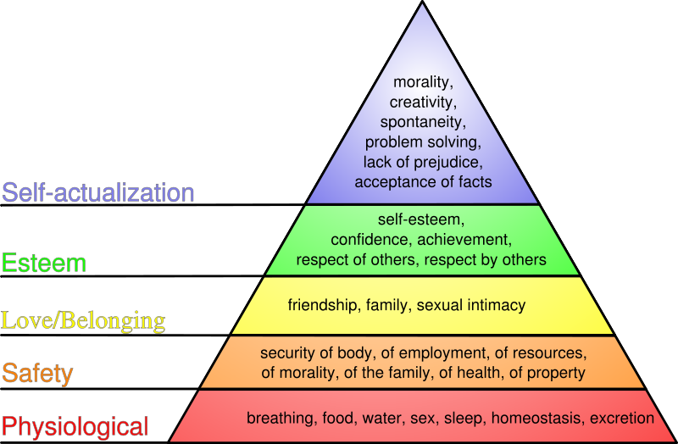
Maslow's Hierarchy of Needs
Notes:
Prejudice; a partiality that prevents objective consideration of an issue or situation

Slide 7
Basic Human Needs
Maslow,s hierarchy of needs is based on theory that something will be called basic needs if :
Those needs are not met – cause illness
Those needs are met - can prevent illness
Those needs are an indicator of health/wellness
There is sense of loss if those needs are’nt met
There is satisfaction if those needs are met

Slide 8
10 Basic Human Needs
Clean environment
Adequate supply of water
Clothing
Nutritious food
Shelter
Health care
Communication
Fuel and lighting (Energy)
Access to education
Cultural and spiritual engagement

Slide 9
World Health Organization
Introduction
World Health Organization is established on 7th April 1948.
It is a specialized, non-political, health agency of United Nation with headquarter of Geneva, Switzerland.
It is responsible for providing leadership on global health matters.
Every year 7th April, is celebrated as “World Health day”.

Slide 10
WHO…….
Vision
“The attainment by all people, the highest level of health”
Mission
“To lead strategic collaborative efforts among Member States and other partners to promote equity in health, to combat disease, and to improve the quality of, and lengthen, the lives of the all peoples of the world.”

Slide 11
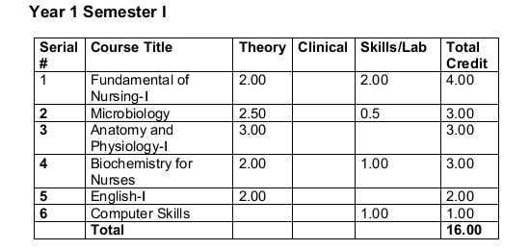
Conceptual Framework for generic BSN program

Slide 12
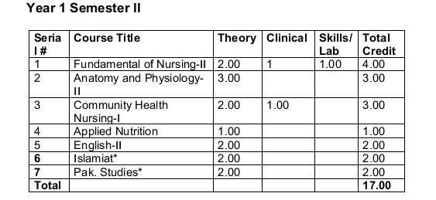
Cont……

Slide 13
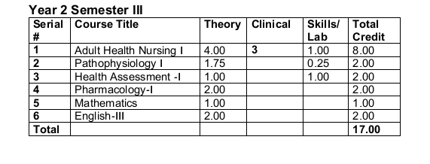
Cont….

Slide 14
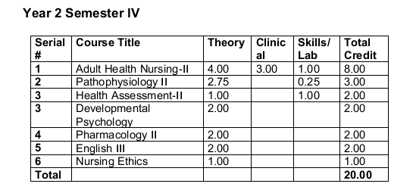
Cont….

Slide 15
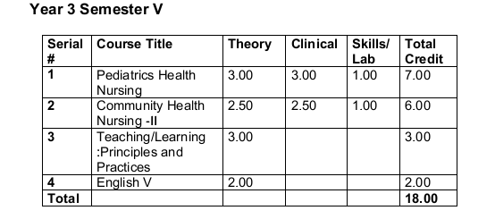
Cont…..

Slide 16
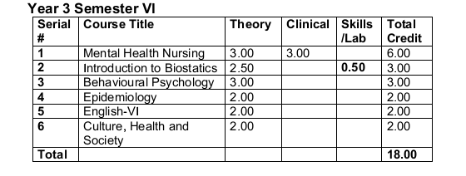
Cont……

Slide 17
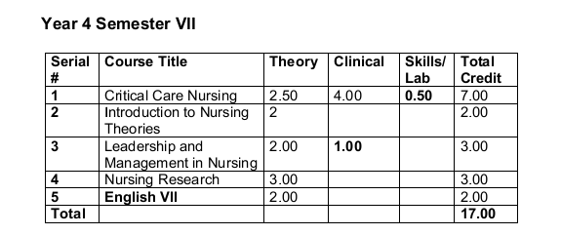
Cont……

Slide 18
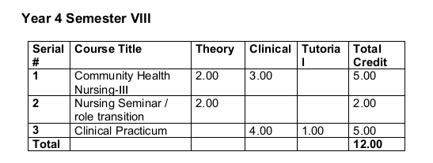
Cont…..

Slide 19
Nursing
Definition: “It is the diagnosis and treatment of human responses to actual or potential health problems” (ANA 1980 )
Nursing is the art and science that involves working with individual, families, and communities to promote wellness of body, mind, and spirit.

Slide 20
Nursing……
Definition “ It is assisting the individual, sick or well in the performance of those activities contributing to health or its recovery (to peaceful death) that he will perform unaided, if he had the necessary strength, will or knowledge and to do this in such a way as to help him gain independence as rapidly as possible” (Virginia Henderson 1960).

Slide 21
Nursing Process
A systematic problem solving approach used to identify, prevent and treat actual or potential health problems and promote wellness.
It involves the following steps
Assessment
Nursing Diagnosis
Planning
Implementation
Evaluation

Slide 22
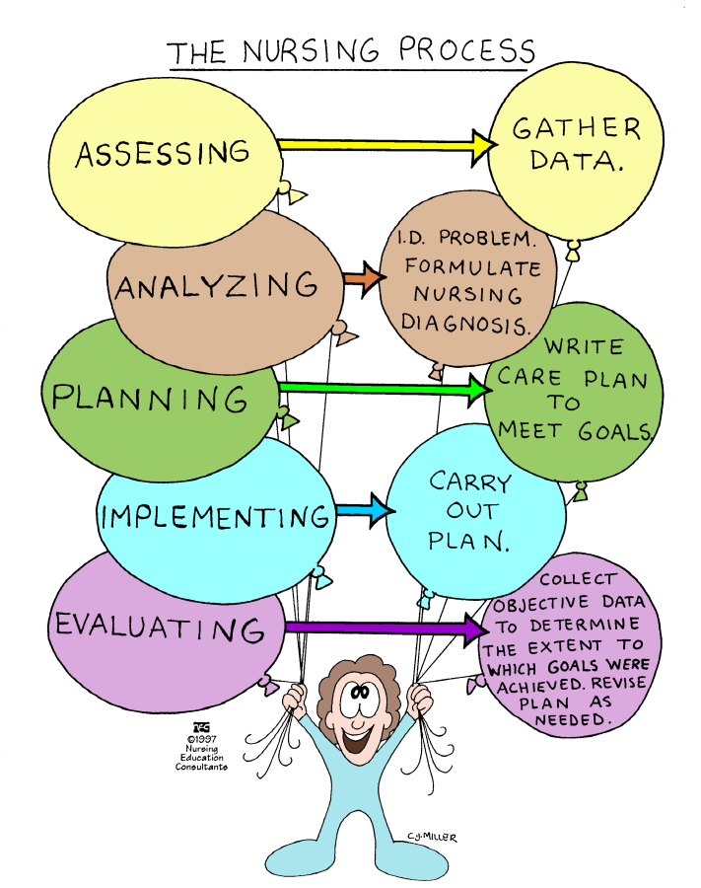

Slide 23
Goals of Nursing process
It is to identify a client ’s health care status,and actual and potential health problems, to establish plans to meet the identified needs, and to deliver specific nursiong intervention to address those needs.
An organizational framework for the practice of nursing
Orderly, systematic ,central to all nursing care
Encompass (cover) all steps taken by the nurse in caring for a patient

Slide 24


Slide 25


Slide 26
References
Andrea Ackermann, Mount St. Mary College, Critical-thinking-the-nursing-process 2001.
http://www.umanitoba.ca/nursing/courses/128,(2005)
Sara-jo Wiscombe, Nursing Process ,Wallace Community College ,May 22,2001.
Tucker C, MODULE A INTRODUCTION TO NURSING Process, August 21, 2002 .

